Slide 1




NEXT GEN EMPLOYABILITY PROGRAM
Creating a future-ready workforce
Team Members
College Name
Student Name : POORNA CHANDRA GANESH
Student ID : 513521104036
Annai Mira College of Engineering and Technology (5135)

Slide 2

CAPSTONE PROJECT SHOWCASE
Project Title
Building Bus Reservation System using Python and Django
Abstract | Problem Statement | Project Overview | Proposed Solution | Technology Used | Modelling & Results | Conclusion

Slide 3
Abstract
The project aims to develop a modern bus reservation system using Python and the Django web framework. In today's fast-paced world, efficient transportation services are crucial, and this system aims to streamline the bus booking process for both passengers and bus operators. The system will allow users to browse available buses, view schedules, reserve seats, and manage their bookings conveniently through a user-friendly web interface.
The booking process is user-friendly, with registered users able to select their preferred bus, choose seats
Passengers can search and browse available buses based on criteria such as origin, destination, date, and time. The system will provide relevant information about available routes, schedules, and fares.
Source :

Slide 4
Problem Statement
Implementing a system that accurately reflects real-time seat availability across different buses and routes presents a significant technical challenge. The system must update seat availability instantly as bookings are made or canceled to prevent overbooking and ensure a smooth booking experience for passengers.Ensuring secure user authentication and data privacy is crucial to protect sensitive customer information and prevent unauthorized access to the reservation system. Robust security measures must be implemented to safeguard user credentials, payment details, and personal information.
Designing an intuitive and user-friendly interface is critical to ensuring a positive user experience. The project must prioritize usability, accessibility, and responsiveness across different devices to cater to a diverse range of users and enhance overall satisfaction with the reservation process.
Source :

Slide 5
Project Overview
The project aims to develop a modern bus reservation system using Python and Django to streamline the booking process for passengers and improve management capabilities for bus operators.
The system will include features such as user registration and authentication, browsing and searching for buses, seat reservation, booking management, admin panel for bus operators, payment integration, responsive design, and robust security measures.
Challenges include implementing real-time seat availability updates, ensuring secure user authentication and data privacy, integrating with payment gateways, ensuring scalability and performance, and designing an intuitive user interface.
Source :

Slide 6
Proposed Solution
Real-time Seat Availability Updates: Implement a system that provides real-time updates on seat availability across different buses and routes, ensuring accurate information for passengers and preventing overbooking.
Secure User Authentication and Data Privacy: Employ robust security measures to ensure secure user authentication and protect sensitive customer information, safeguarding user credentials, payment details, and personal data.
Payment Gateway Integration: Integrate with reliable payment gateways to facilitate secure online payments, supporting various payment methods and ensuring seamless transactions for passengers and reliable revenue collection for bus operators.
Scalability and Performance Optimization: Optimize database management, caching mechanisms, and server infrastructure to ensure scalability and optimal performance, accommodating growing user demands without compromising system responsiveness.
Source :

Slide 7
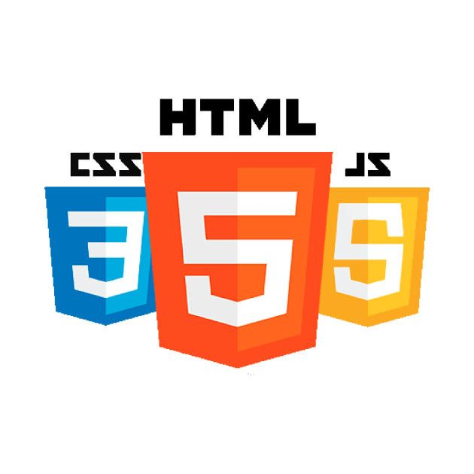

Technology Used
Front-end
Back-end
Source :

Slide 8
Modelling & Results
Database Modeling: Utilize Django's ORM to define database models for buses, reservations, users, etc., ensuring proper relationships between entities and efficient data storage.
Reservation Process Flow: Implement a streamlined reservation process, allowing users to search for available buses, select seats, make reservations, and manage bookings seamlessly through the web interface.
Real-time Seat Availability: Develop algorithms to update seat availability in real-time based on bookings and cancellations, ensuring accurate availability information for users during the reservation process.
Testing and Validation and User Feedback: Conduct thorough testing to validate the system's functionality, including unit tests, integration tests, and user acceptance testing, ensuring that the system performs as expected and meets user requirements.Gather user feedback through surveys, usability testing, and analytics to identify areas for improvement and iterate on the system to enhance user satisfaction and optimize performance over time.
Source :

Slide 9
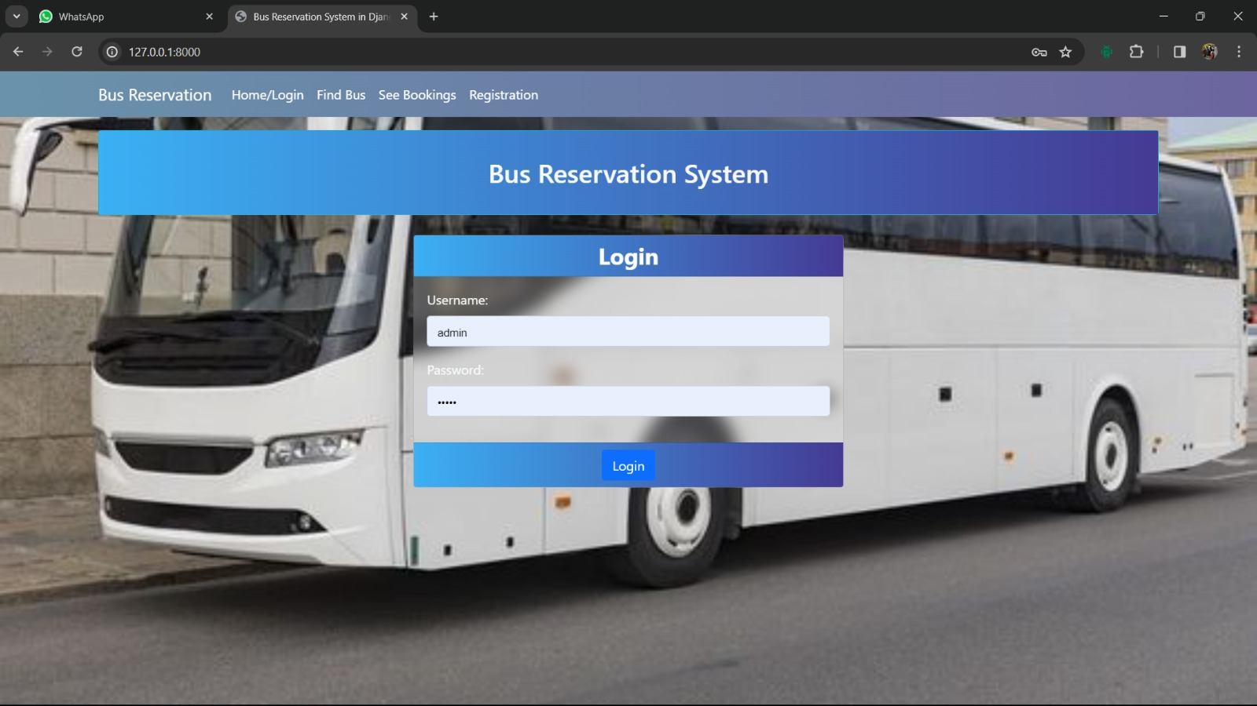
Homepage | Login

Slide 10
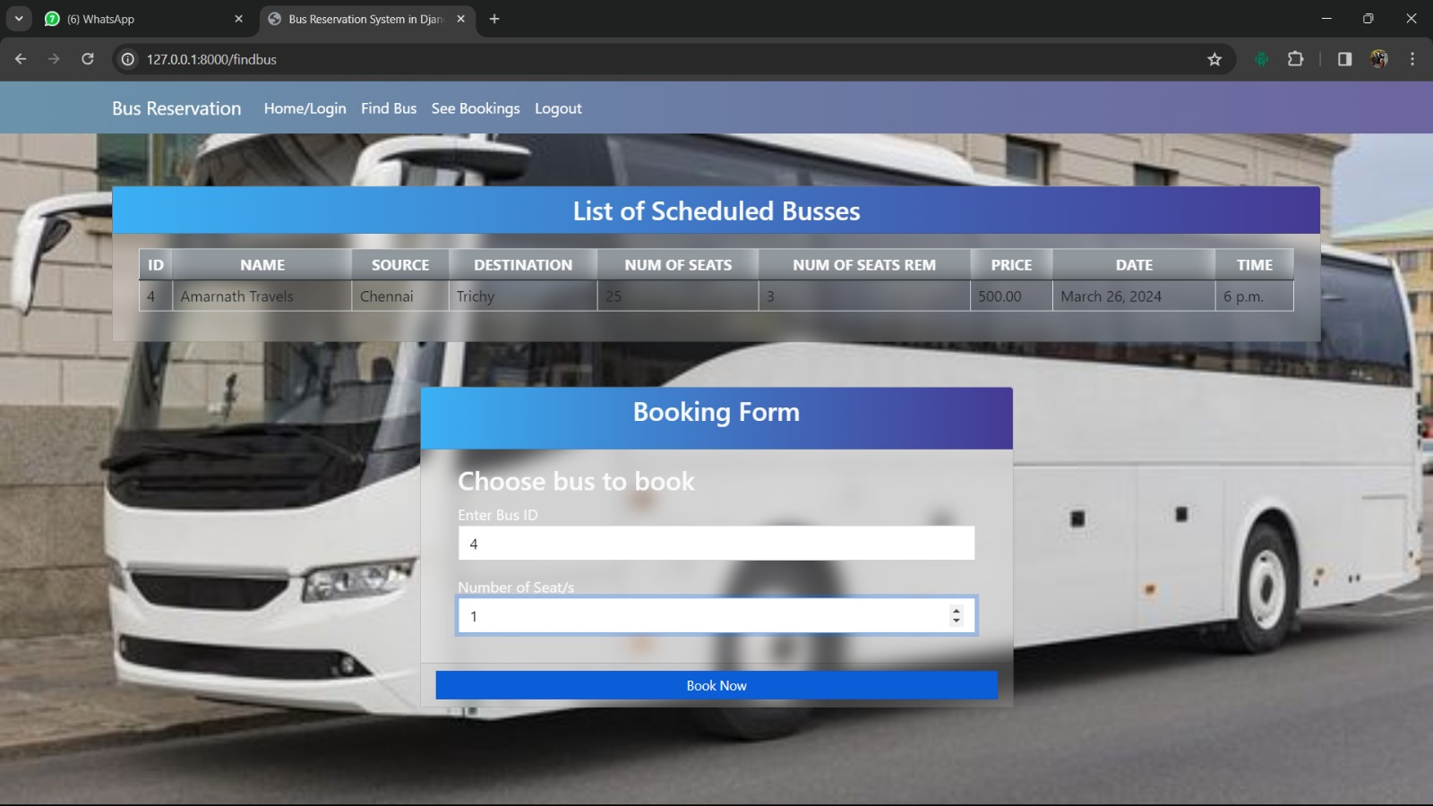
Find Bus and Booking

Slide 11
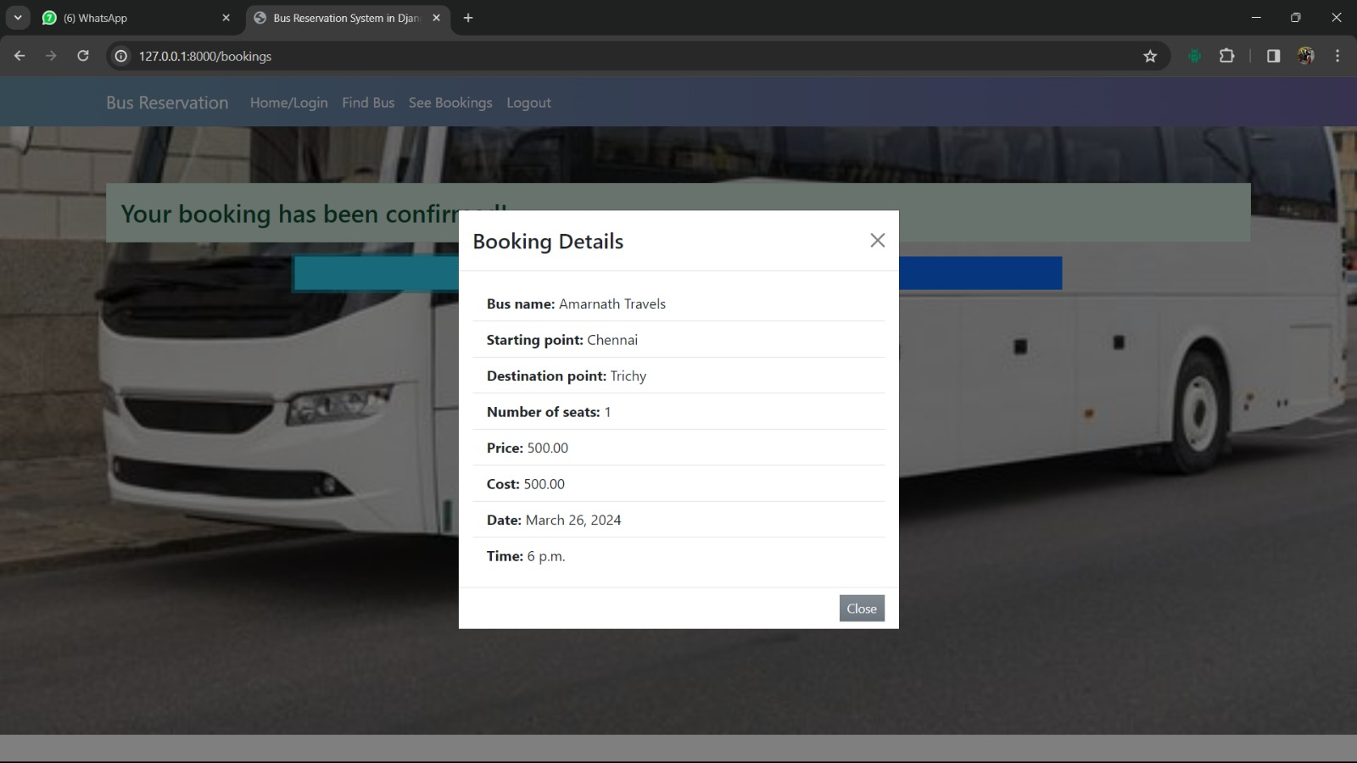
booking details

Slide 12
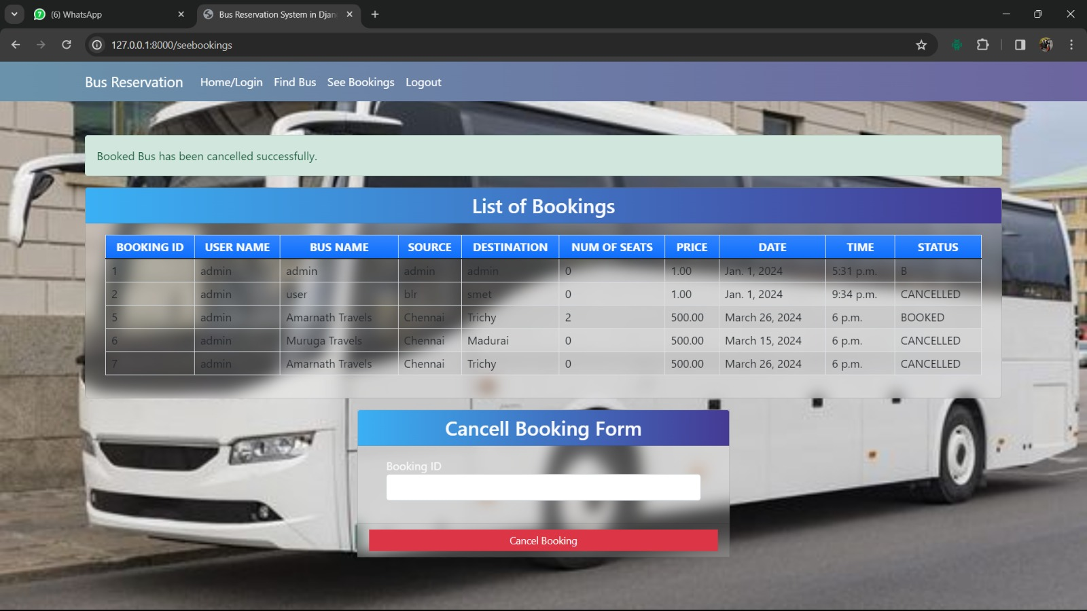
List of Bookings | Cancel Booking

Slide 13
Future Enhancements:
1.Mobile App Development:
2. Integration with Travel APIs
3. Personalized Recommendations
4.Multi-language Support
5. Dynamic Pricing and Revenue Management.
6. Social Integration
7.Voice-enabled Booking Assistant
8. Blockchain-based Ticketing System

Slide 14
Conclusion
The bus reservation system developed using Python and Django revolutionizes the way users book and manage bus tickets, providing a seamless and user-friendly experience from start to finish.
By automating and streamlining the reservation process, the system offers users greater convenience and flexibility in planning their travel, saving time and effort in booking tickets.
Bus operators benefit from robust tools and analytics provided by the system, enabling them to optimize schedules, manage seat availability, and make data-driven decisions to enhance operational efficiency and revenue generation.
With features such as real-time seat availability updates, secure payment integration, and personalized recommendations, the system sets new standards for bus reservation platforms, driving innovation and setting the stage for future advancements in the travel industry.
Source :

Slide 15
Thank You!
Notes:
Thank You !!

